Slide 1
CLC1151: Chinese 1 (For Non-Chinese Speaking Students)
Chinese Language Centre
PolyU
Sarah Wong

Slide 2
你们好 Hi, everyone
自我介绍 Self-introduction
课程简介 Course information
分流考试 Placement test

Slide 3
我 About Me
sarah.wong@polyu.edu.hk
黄静心Wong Ching Sum, Sarah
MA, PKU. BEd, HKU.
Instructor, PolyU (2015-)
Chinese Courses for local and international students (mainly CLC1151).

Slide 4
Introduce yourself

Slide 5
Teaching Schedule
+10% class participation

Slide 6
What you will learn?
Find a Chinese name for yourself
Pinyin (phonetic symbols)
Chinese characters
Simple grammar rules
Daily conversations (6 lessons)

Slide 7
Characters
lǎo shī
老师
bèi
贝
bǐ
匕
zhōng
中
rén
人
rì
日
zhě
者
shǐ
矢
shēng
生
yù
玉

Slide 8
Lesson 1: Hello

Slide 9
Lesson 2: Are you busy?

Slide 10
Lesson 3: Where does she come from?

Slide 11
Lesson 4: Nice to meet you

Slide 12
Lesson 5: Where is the restaurant?

Slide 13
Lesson 6: Let’s go swimming, ok?

Slide 14
测验一 Quiz 1
20%
Listening (pinyin)
Multiple choices
@BlackBoard

Slide 15
测验二 Quiz 2
20%
You will be asked to read two dialogs from text book

Slide 16
测验三 Quiz 3
20%: Written part @BlackBoard
30%: Oral part
prepare a presentation and answer questions
+
10% class participation

Slide 17
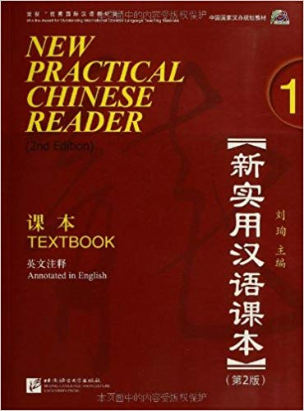
Textbook
New Practical Chinese Reader Vol. 1, Beijing Language and Culture University Press. (2nd Edition)

Slide 18
Placement test (pre-test)

